Slide 1

Rules of Jeopardy!
To start the game, click on the first Jeopardy! Slide and start the presentation by clicking on the menu Slide Show > From Current Slide.
Now the intro with music starts playing and you only must click one more time to run the begin animation. When the second money board appears, the first player can choose the category and money- value by clicking on the field. (With the increasing amount of money, the difficulty of the questions also increases!)
As soon the question appears, the players have 30 seconds to think about it. (until music ends) When one person raises his arm (or shouts) he/ she can answer. Answers must be phrased as questions, unless it’s said differently.
Right answer? Then the player gets the amount of money, the question is worth. Take a sheet and write down the value to the persons' name. If he guessed it wrong, the other players could try their luck. If time runs out, or no one got it, no one will get any points. The person with the highest amount of money, wins.
Advanced version: guessing it wrong will subtract the amount of money from the players account; negative values are also accurate.

Slide 2


To change the text, click on the text field on the specific slide, then rewrite questions and answers.
Pictures can also be changed by selecting them and choosing “From a File” in the picture options “Picture Format”.
Some pictures are hidden behind other elements. In order to change them, move objects around and bring them to the front or back by right-clicking them and choosing the option.

Slide 4

































Insects
Structures
More structures
Mouth Parts
Butterflies and Moths
Social Insects
YOU FINISHED THIS GAME
TIME TO COUNT THE MONEY!

Slide 5

All insects have three pairs of .
Click here for the answer

Slide 6
Solution:
legs
$ 200

Slide 7
Name three body sections of an insect.
Click here for the answer

Slide 8
Solution:
head
abdomen
thorax
$ 400

Slide 9
What stages does complete metamorphosis have that incomplete metamorphosis does not have?
Click here for the answer

Slide 10
Solution:
larva and pupa
$ 600

Slide 11
Insects are arthopods because they have these three things.
Click here for the answer

Slide 12
Solution:
jointed legs
exoskeleton
body sections
$ 800

Slide 13
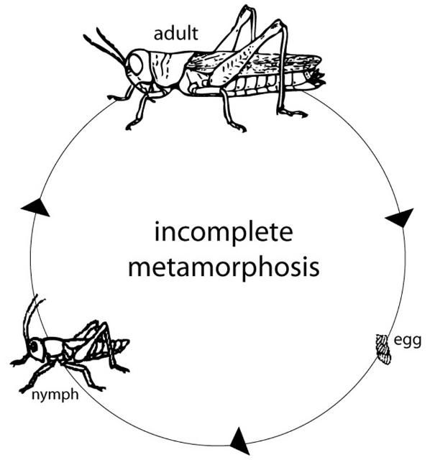
What is the missing stage of incomplete metamorphosis?
Click here for the answer

Slide 14
Solution:
nymph
$ 1000

Slide 15
This structures makes it harder for a predator to eat an insect.
Click here for the answer

Slide 16
Solution:
its exoskeleton
$ 200

Slide 17
Insect wings and feet provide escape from predators by .
Click here for the answer

Slide 18
Solution:
providing speed
$ 400

Slide 19
What structures aid an insect in gathering information about its environemnt?
Click here for the answer

Slide 20
Solution:
antenna and eyes
$ 600

Slide 21
What is it called when a harmless insect looks like a harmful insect?
Click here for the answer

Slide 22
$ 800
          Solution:
mimicry

Slide 23
What are two functions of all insect wings?
Click here for the answer

Slide 24
Solution:
escaping and holding in heat
$ 1000

Slide 25
Name two external structures connected to the thorax.
Click here for the answer

Slide 26
Solution:
wings
legs
$ 200

Slide 27
Where are the structures for digesting food located?
Click here for the answer

Slide 28
Solution:
abdomen
$ 400

Slide 29
An insect might use to hides in its surroundings.
Click here for the answer

Slide 30
Solution:
camouflage
$ 600

Slide 31
These external structures detect odors, sense touch, and detect sound vibrations.
Click here for the answer

Slide 32
Solution:
antennae
$ 800

Slide 33
What are three ways that compound eyes and simple eyes are different?
Click here for the answer

Slide 34
Solution:
the number of lenses each one has
the area that can be seen with each one
the number of pieces in the image seen
$ 1000

Slide 35
What is the small tube in an insect‘s head that is used to suck liquid called?
Click here for the answer

Slide 36
Solution:
proboscis
$ 200

Slide 37
Insects that drink liquids from plant leaves have what type of mouthparts?
Click here for the answer

Slide 38
Solution:
piercing-sucking
$ 400

Slide 39
Insects that drink only nectar from flowers have what type of mouthpart?
Click here for the answer

Slide 40
Solution:
siphoning
$ 600

Slide 41
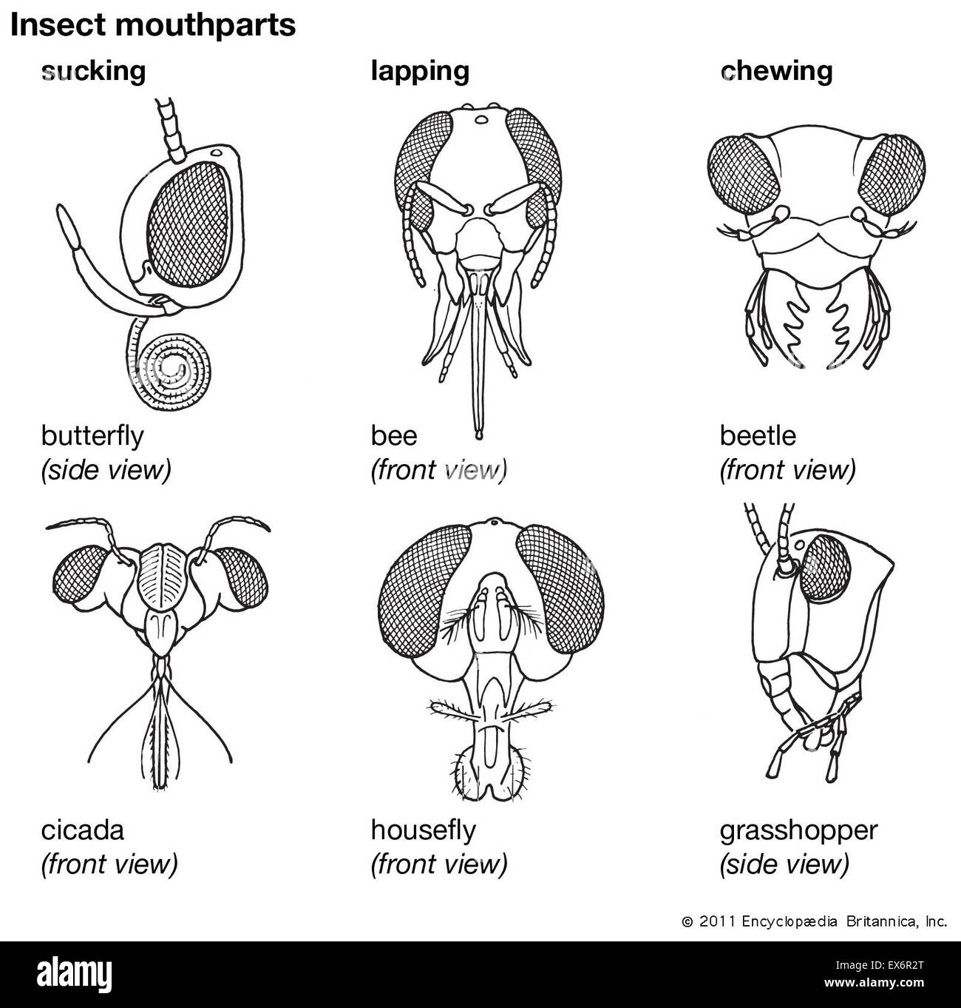
What type of mouthpart does this insect have?
Click here for the answer

Slide 42
Solution:
sponging
$ 800

Slide 43
What type of mouthpart does this insect have?
Click here for the answer

Slide 44
Solution:
chewing
$ 1000

Slide 45
Which has colorful patterns and small scales, a butterfly or a moth?
Click here for the answer

Slide 46
Solution:
butterfly
$ 200

Slide 47
Does a butterfly or a moth have wings fold flat or spread out when resting?
Click here for the answer

Slide 48
Solution:
moths
$ 400

Slide 49
Butterflies and moths have different coverings during which stage of metamorphosis?
Click here for the answer

Slide 50
Solution:
pupa
$ 600

Slide 51
What are three characteristics of moths (that are different than a butterfly)?
Click here for the answer

Slide 52
Solution:
thick and feathery antennae
pupa covering is a cocoon
fly and feed at night
$ 800

Slide 53
What are three characteristics of both the butterflies and moths?
Click here for the answer

Slide 54
Solution:
compound eyes
complete metamorphosis
siphoning mouthparts
$ 1000

Slide 55
What are two ways that the design of a beehive helps bees to survive and grow?
Click here for the answer

Slide 56
Solution:
protects the eggs and keeps the honey from splling out
$ 200

Slide 57
Which social insects communicate by using vibrations?
Click here for the answer

Slide 58
Solution:
termites
$ 400

Slide 59
The ants that gather food to feed the larvae are the ants.
Click here for the answer

Slide 60
Solution:
worker
$ 600

Slide 61
How are social insects different from other insects?
Click here for the answer

Slide 62
Solution:
They survive by living and working together in colonies. Most insects do not live and work together.
$ 800

Slide 63
How did God design termites as social insects?
Click here for the answer

Slide 64
Solution:
God gave them instincts that make them behave in a certain way.
Termites work together to survive and accomplish things they could not do alone.
$ 1000

